Slide 1
AWS DevOps Internship Project
Project – 1
- SADA SIVA REDDY

Slide 2
DEPLOY 3-TIER ARCHITECTURE IN AWS USING TERRAFORM

Slide 3
What is Terraform?
Terraform is an open-source Infrastructure as Code (IaC) tool developed by HashiCorp. It allows users to define and provision infrastructure resources in a declarative configuration language. With Terraform, you can describe the desired state of your infrastructure, and the tool will automatically create and manage the resources to match that state.
Terraform can manage low-level components like compute, storage, and networking resources, as well as high-level components like DNS entries and SaaS features.

Slide 4
How does terraform work?
Terraform creates and manages resources on cloud platforms and other services through their application programming interfaces (APIs). Providers enable Terraform to work with virtually any platform or service with an accessible API.
The core Terraform workflow consists of three stages:
Write:
In the "write" stage, users create Terraform configuration files (.tf) using HashiCorp Configuration Language (HCL) or JSON. These files describe the desired state of the infrastructure, including resources, settings, and dependencies.
Plan:
The "plan" stage is about generating an execution plan based on the current state and the desired state specified in the Terraform configuration files. It shows what Terraform will do before actually making any changes to the infrastructure.
Apply:
The "apply" stage is where Terraform executes the planned changes, creating, updating, or destroying resources to match the desired state.

Slide 5
Why Terraform?
Manage any infrastructure
Track your infrastructure
Automate changes
Multi cloud Support
Version Control Integration

Slide 6
3-Tier Architecture
Three-tier architecture is a well-established software application architecture that organizes applications into three logical and physical computing tiers: the presentation tier, or user interface; the application tier, where data is processed; and the data tier, where the data associated with the application is stored and managed.
The chief benefit of three-tier architecture is that because each tier runs on its own infrastructure, each tier can be developed simultaneously by a separate development team, and can be updated or scaled as needed without impacting the other tiers.

Slide 7
The three tiers in detail
Presentation tier
The presentation tier is the user interface and communication layer of the application, where the end user interacts with the application. Its main purpose is to display information to and collect information from the user. This top-level tier can run on a web browser, as desktop application, or a graphical user interface (GUI)
Application tier
The application tier, also known as the logic tier or middle tier, is the heart of the application. In this tier, information collected in the presentation tier is processed
Data tier
The data tier, sometimes called database tier, data access tier or back-end, is where the information processed by the application is stored and managed. This can be a relational database management system such as PostgreSQL, MySQL, MariaDB, Oracle…

Slide 8
Steps to create 3-Tier Architecture using terraform scripts:
Create file for VPC.
Create file for Subnets.
Create file for Internet Gateway.
Create file for Route Tables.
Create file for Security Groups For Front-end tier.
Create file for Security Groups For Database tier.
Create file for EC2 Instances.
Create file for Application Load-balancer.
Create file for RDS.
Create file for variables.
Create file for Outputs.

Slide 9
Launch an EC2 Instance

Slide 10
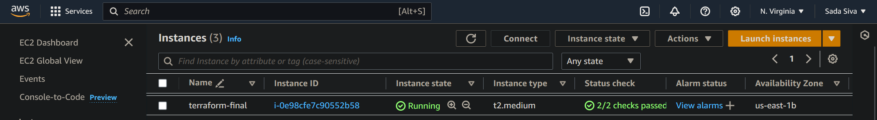
Launch an EC2 Instance with Specifications AMI-amazon Linux 2, t2.micro Enable port 22(SSH) and 80(HTTP) Now connect it to the server with SSH command, $ ssh –i<pemfile> ec2-user@ip-address Now install terraform to our instance from terraform official page sudo yum install -y yum-utils shadow-utils sudo yum-config-manager --add-repo https://rpm.releases.hashicorp.com/AmazonLinux/hashicorp.repo sudo yum -y install terraform

Slide 11
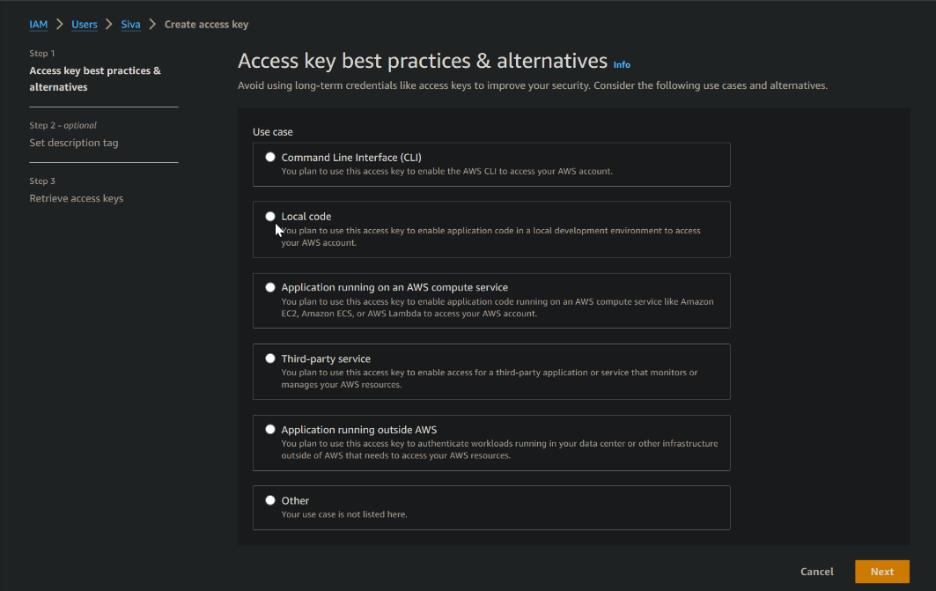
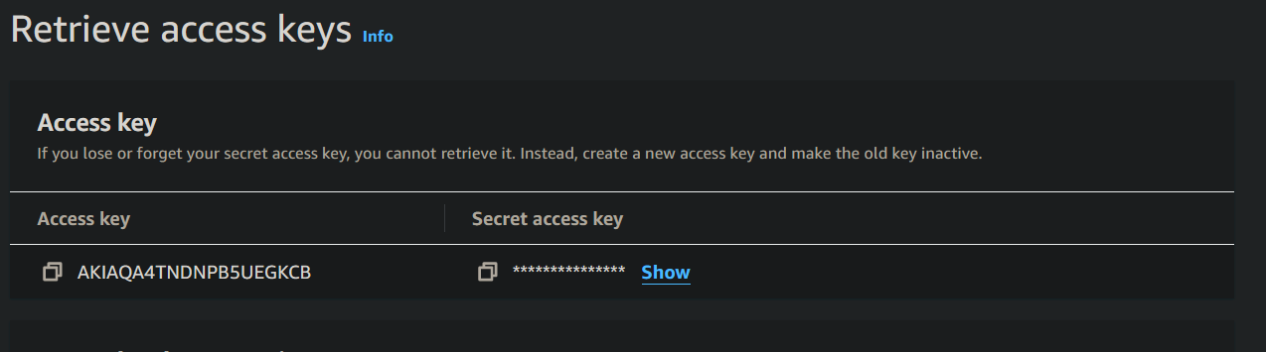
Now create access key and secret key
Terraform asks Access keys ID and secret key ID to execute terraform workflow commands
So, we need to create this from AWS Account
IAM → USERS → USER SECURITY
After that generate Access key and secret key
In terminal execute this command
$ aws configure
After that execute
$ terraform init

Slide 12
Create a provider file

Slide 13
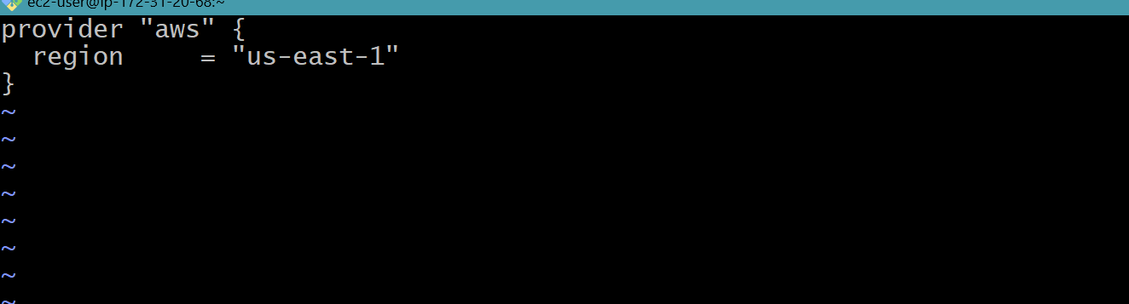
Provider.tf
In Terraform, the provider file is used to configure and define the details of the cloud or infrastructure provider that you want to use. A provider in Terraform is a plugin that enables interaction with a specific API or service. The provider file typically contains configuration settings, such as access credentials and region information, specific to the chosen provider
Create a file <filename.tf>
Execute terraform execution flow
commands
$ terraform fmt
$ terraform validate
$ terraform plan

Slide 14
Create a file for VPC

Slide 15
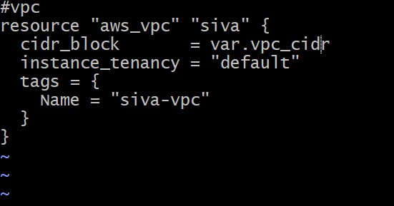
Vpc.tf
Virtual Private Cloud (VPC) is a logically isolated section of a cloud service provider's infrastructure that allows users to provision and manage their own virtualized network. It acts as a private and isolated segment within the cloud environment, providing a customizable network topology and control over various networking aspects.
Create a file for vpc $<filename.tf>
Execute terraform execution flow
commands
$ terraform fmt
$ terraform validate
$ terraform plan

Slide 16
Create a file for subnet

Slide 17
Subnet.tf
Subnets play a crucial role in networking and cloud computing, serving as a way to logically divide and organize IP address space within a larger network.
Create a file for subnet $<filename.tf>
Execute terraform execution flow commands
$ terraform fmt
$ terraform validate
$ terraform plan

Slide 18
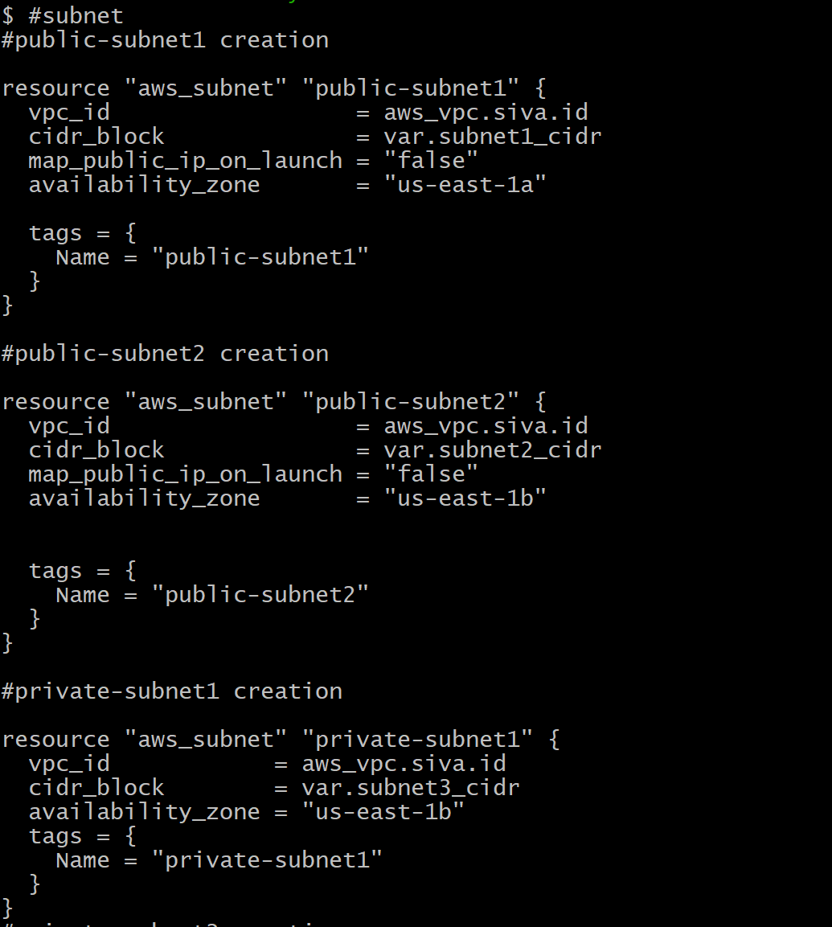
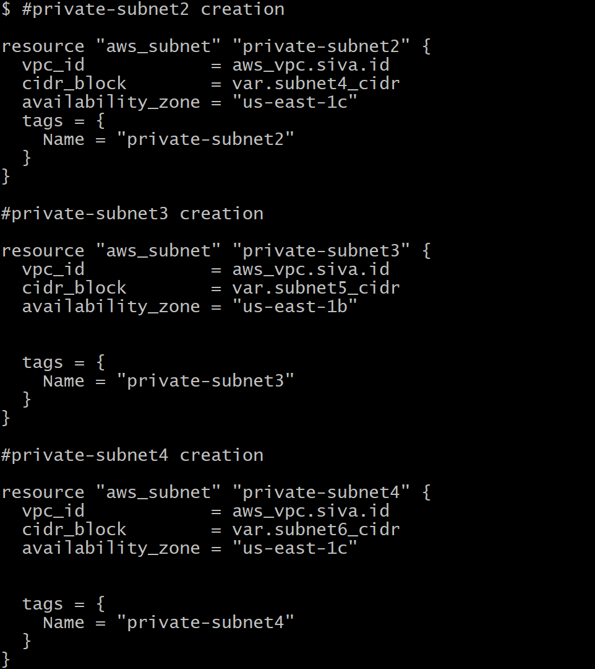
Subnet Script

Slide 19
Create a file for Internet Gateway

Slide 20
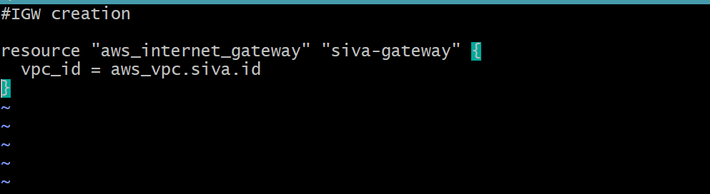
Internet Gateway.tf
The primary use of an Internet Gateway is to enable communication between resources within a VPC and the public internet.
Create a file for Internet Gateway $<filename.tf>
Execute terraform execution flow commands
$ terraform fmt
$ terraform validate
$ terraform plan

Slide 21
Create a file for Route Tables

Slide 22
Route-Table.tf
A route table is a fundamental component in networking that is used to control the routing of traffic within a network. The primary purpose of a route table is to determine the paths that network traffic takes between subnets, the internet, and other network destinations.
Create a file for Route Table $<filename.tf>
Execute terraform execution flow commands
$ terraform fmt
$ terraform validate
$ terraform plan

Slide 23
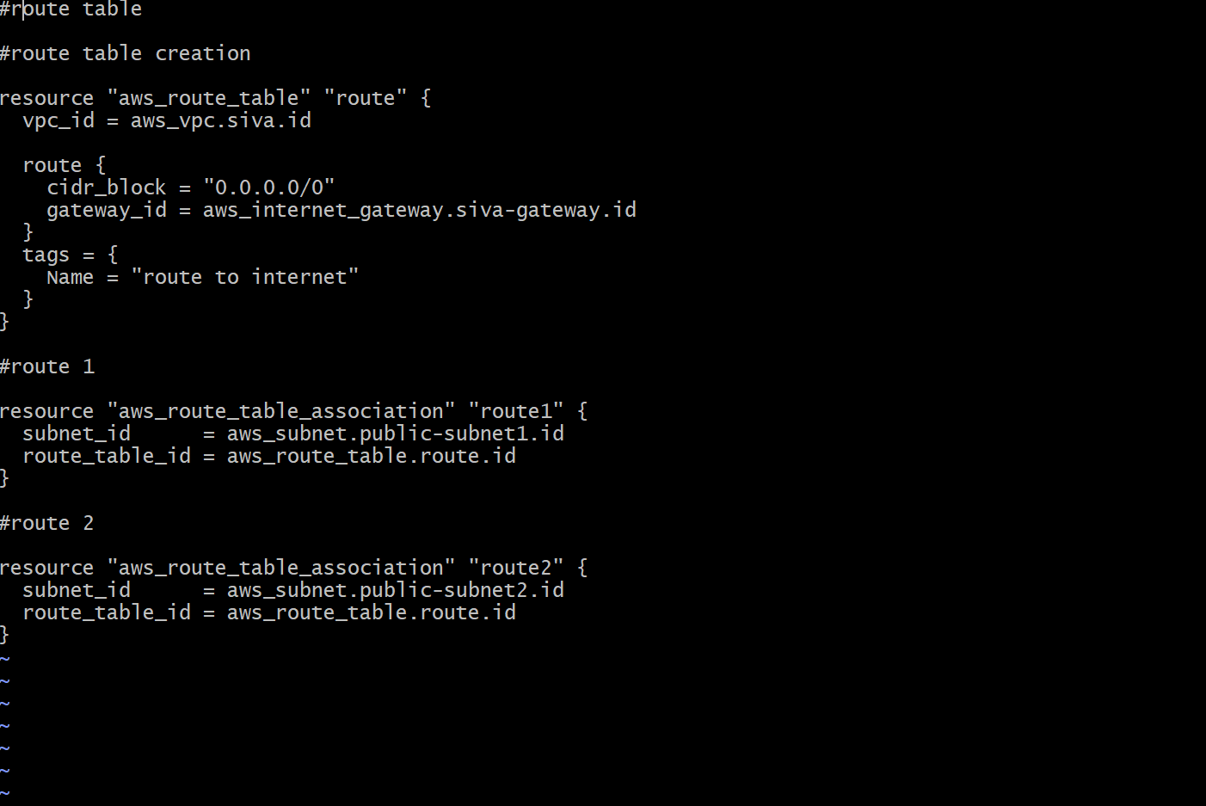
Route-Table Script

Slide 24
Creating a file for the security group for frontend tier

Slide 25
Security group for frontend tier
In cloud computing environments like AWS, a Security Group is a fundamental component used to control inbound and outbound traffic to resources, such as instances (virtual machines), within a Virtual Private Cloud (VPC). Security Groups act as virtual firewalls, allowing or denying traffic based on defined rules.
Create a file for frontend tier $<filename.tf>
Execute terraform execution flow commands
$ terraform fmt
$ terraform validate
$ terraform plan

Slide 26
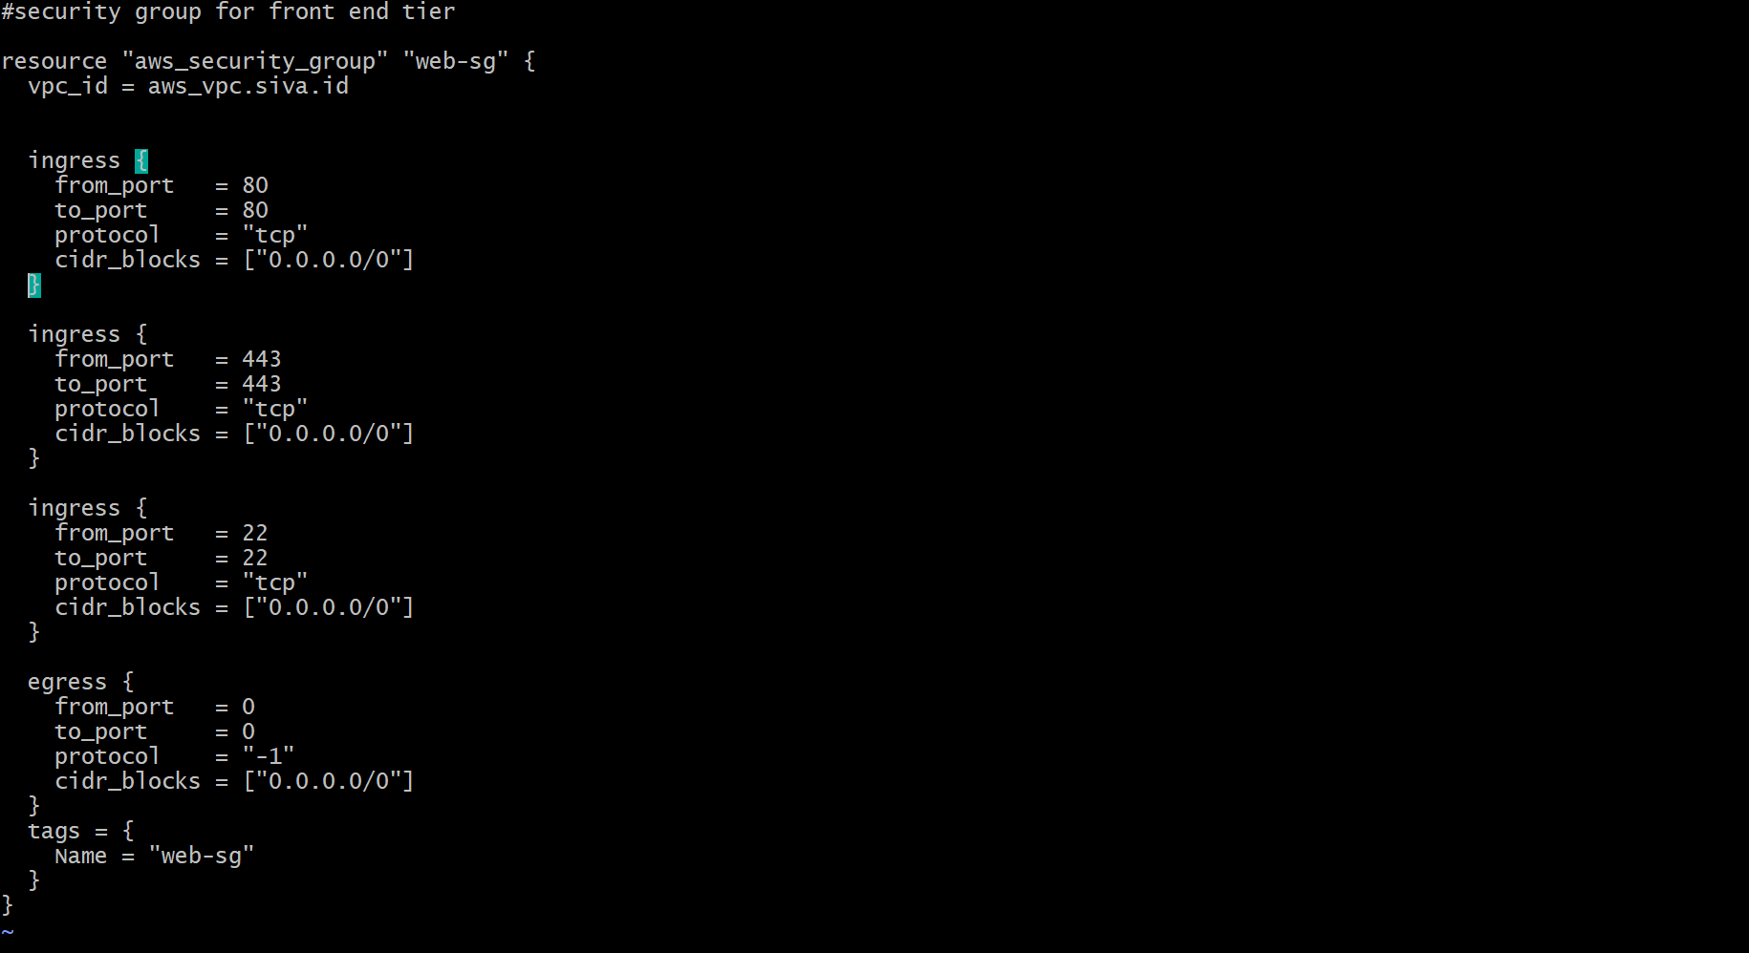
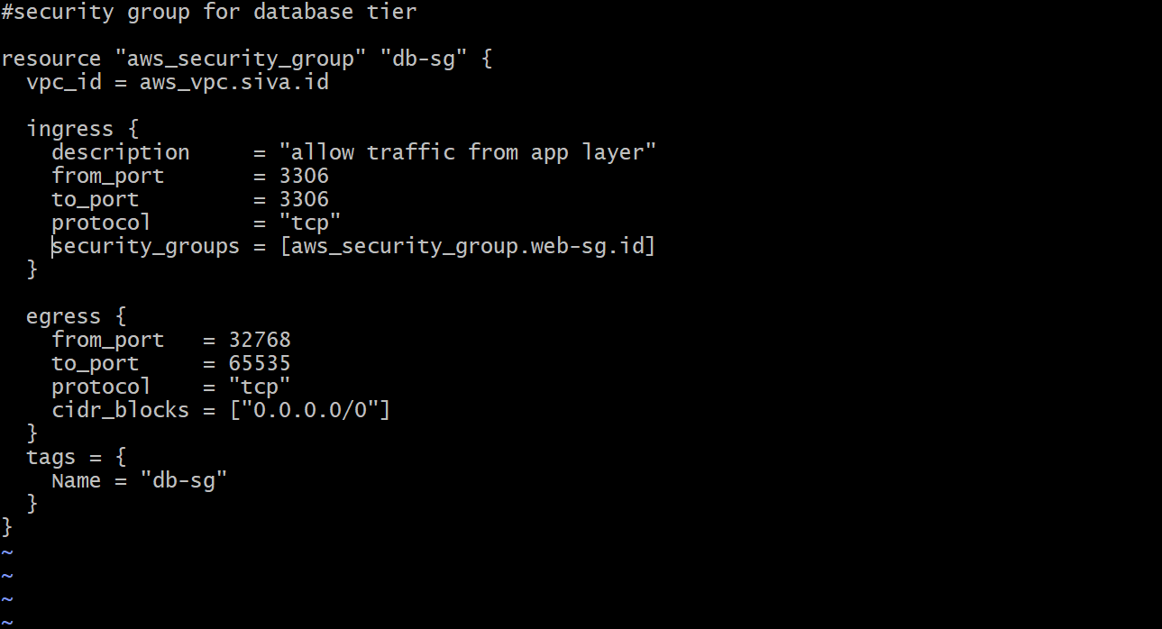
Script for frontend and data-base tier
Frontend tier
Data base tier

Slide 27
Creating a bash script file for launching EC2 Instance

Slide 28
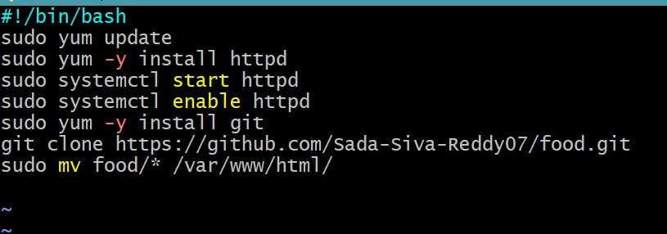
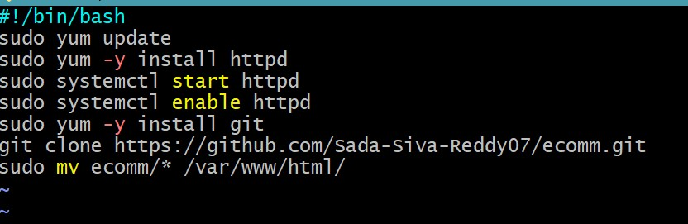
Bash-Script data
Data1.sh
Data2.sh

Slide 29
Creating a file for EC2 Instance

Slide 30
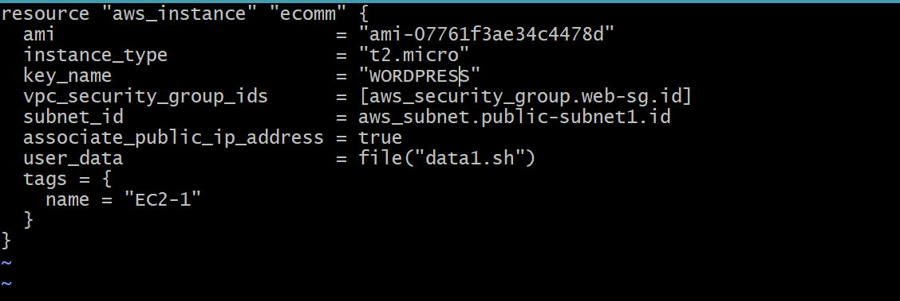
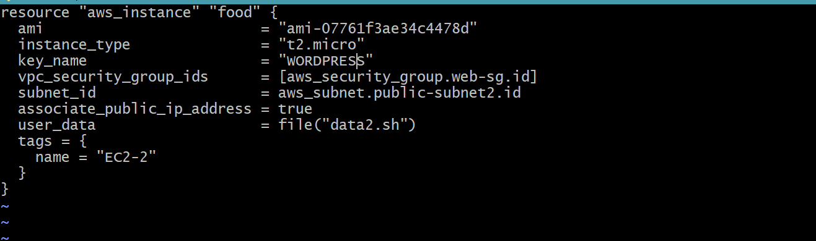
EC2 Instance Script
Ec1 instance script
Ec2 instance script
Create a file by using $<filename.tf> for two instances
Execute terraform commands
$ terraform fmt
$ terraform validate
$ terraform plan

Slide 31
Create a file for Application Load Balancer

Slide 32
Application Load Balancer
An Application Load Balancer (ALB) is a service provided by cloud providers like AWS (Amazon Web Services) that distributes incoming application traffic across multiple targets, such as EC2 instances, in multiple Availability Zones. ALBs operate at the application layer (Layer 7) of the OSI model, allowing them to route traffic based on content, making them suitable for modern web applications.
Create a file for frontend tier $<filename.tf>
Execute terraform execution flow commands
$ terraform fmt
$ terraform validate
$ terraform plan

Slide 33
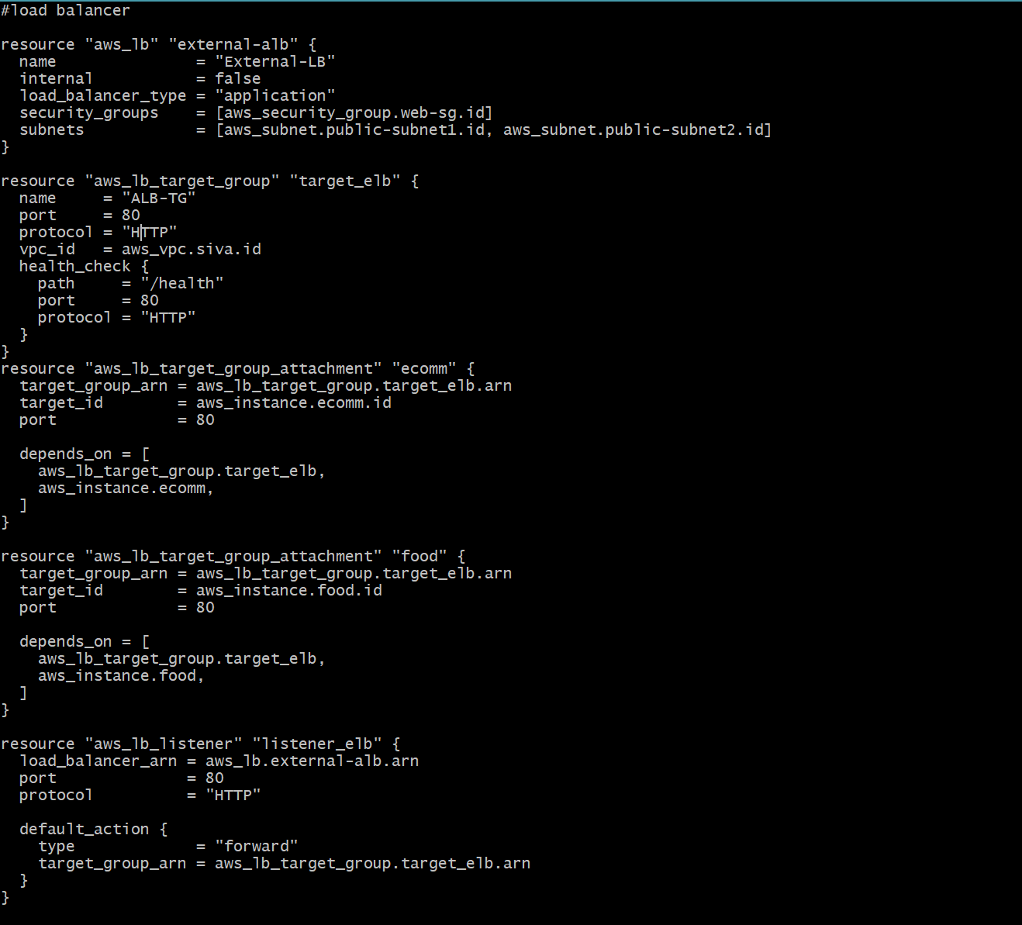
Application Load Balancer Script
A target group is a collection of instances that receive traffic from the ALB. You create a target group and register instances with it.
Define a listener to handle incoming traffic on a specified port and protocol. You also configure the listener to forward traffic to the target group.

Slide 34
Create a file for RDS

Slide 35
Relational Database Service (RDS)
Amazon RDS (Relational Database Service) is a managed database service provided by Amazon Web Services (AWS) that simplifies the setup, operation, and scaling of relational databases. RDS automates many common administrative tasks associated with databases, allowing developers to focus on building applications rather than managing database infrastructure.
Create a file for rds $<filename.tf>
Execute terraform execution flow commands
$ terraform fmt
$ terraform validate
$ terraform plan

Slide 36
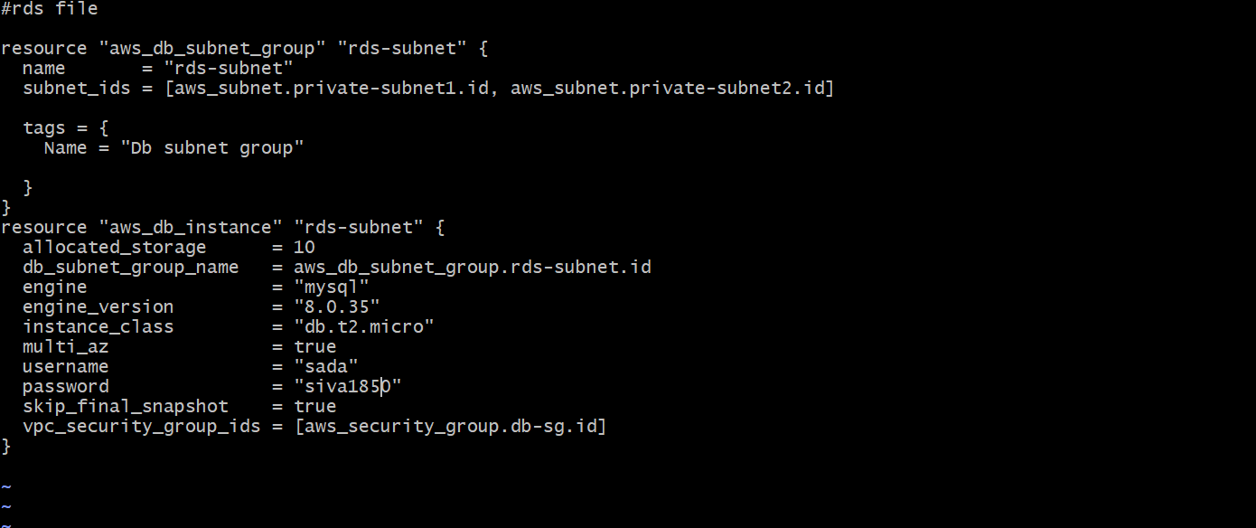
Script for RDS

Slide 37
Create a file for Variable

Slide 38
Variable file
In the context of infrastructure as code (IaC) tools like Terraform, a variable file is a file that contains declarations and assignments of variables used in the Terraform configuration. Variables in Terraform allow you to parameterize your configurations, making them more flexible and reusable. By using variable files, you can easily customize the values of these variables without modifying the main configuration files.
Create a file for Variable file $<filename.tf>
Execute terraform execution flow commands
$ terraform fmt
$ terraform validate
$ terraform plan

Slide 39
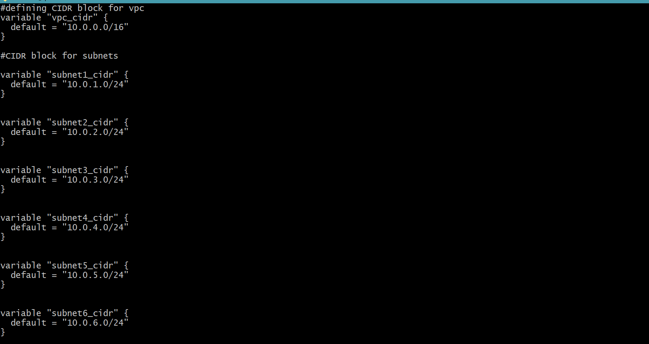
Script for variable file

Slide 40
Create a file for Output

Slide 41
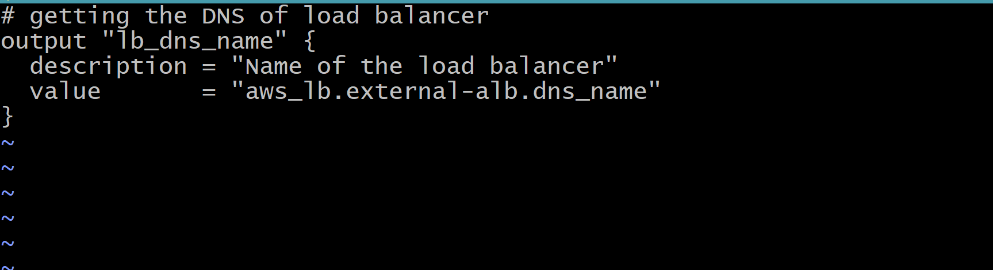
Output File
Create a file for output $<filename.tf>
Execute terraform execution flow commands
$ terraform fmt
$ terraform validate
$ terraform plan

Slide 42
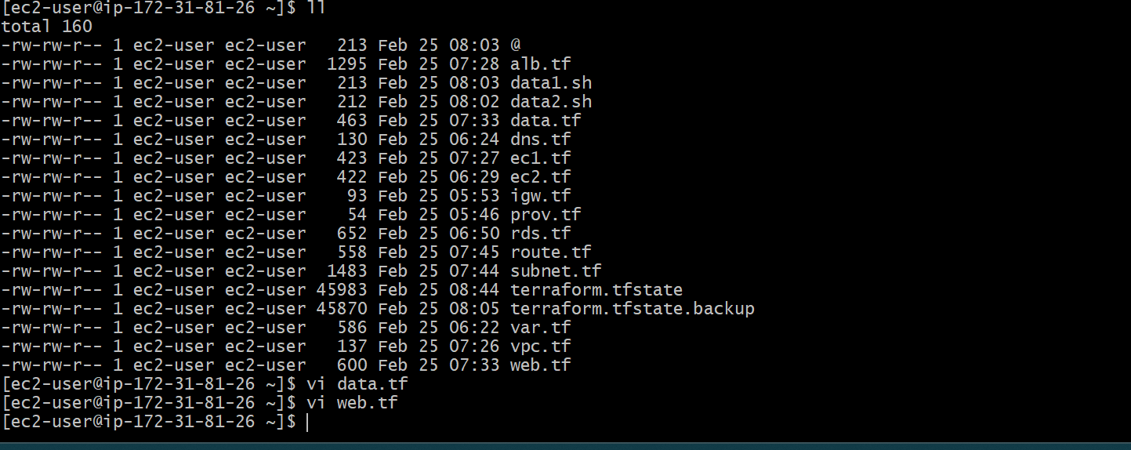
List of Created files

Slide 43
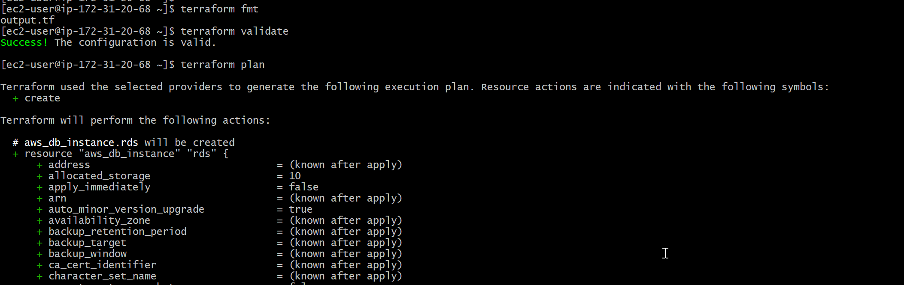
After all the scripts are formatted, validated, and planned. Give command $ terraform apply Then, all the resources are created as per the terraform scripts.

Slide 44
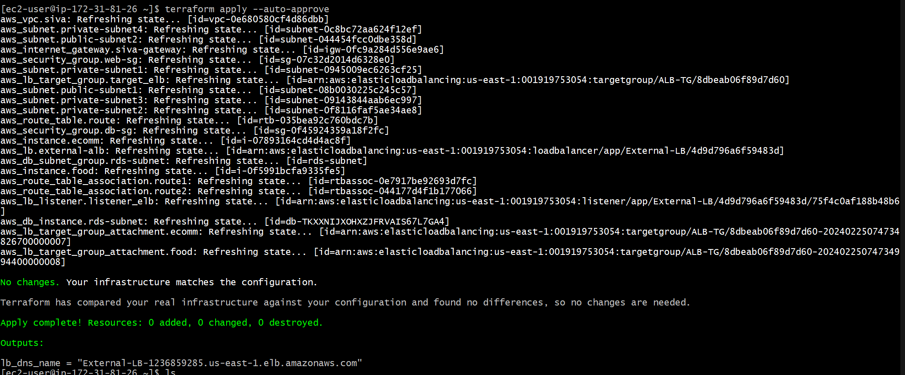
DNS address
In Output Column
There is a DNS name, copy it and browse

Slide 45

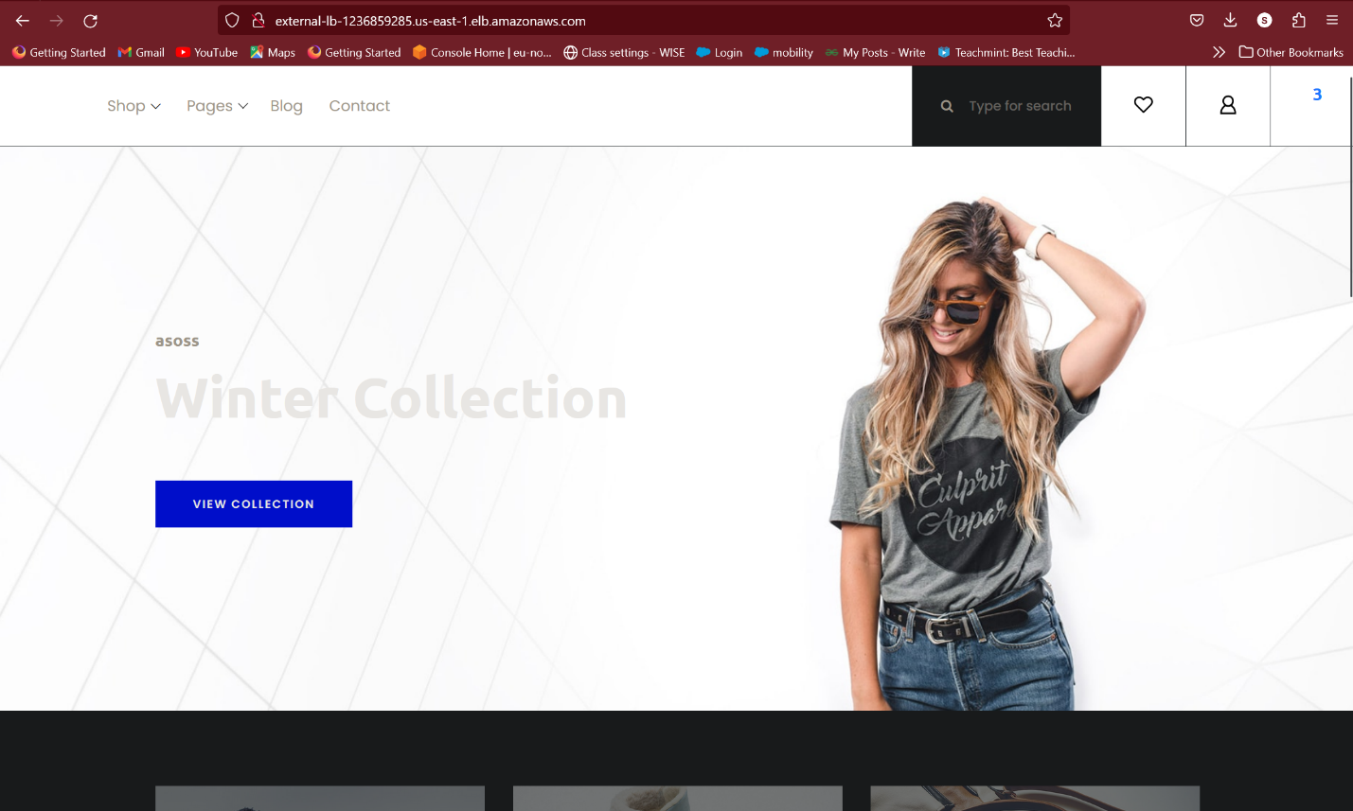

Slide 46
Verify the resources
VPC
Public & Private Subnets
Route Tables
Internet Gateway
EC2 Instances
RDS Instance
Application Load Balancer
Security Groups for web & RDS Instances

Slide 47
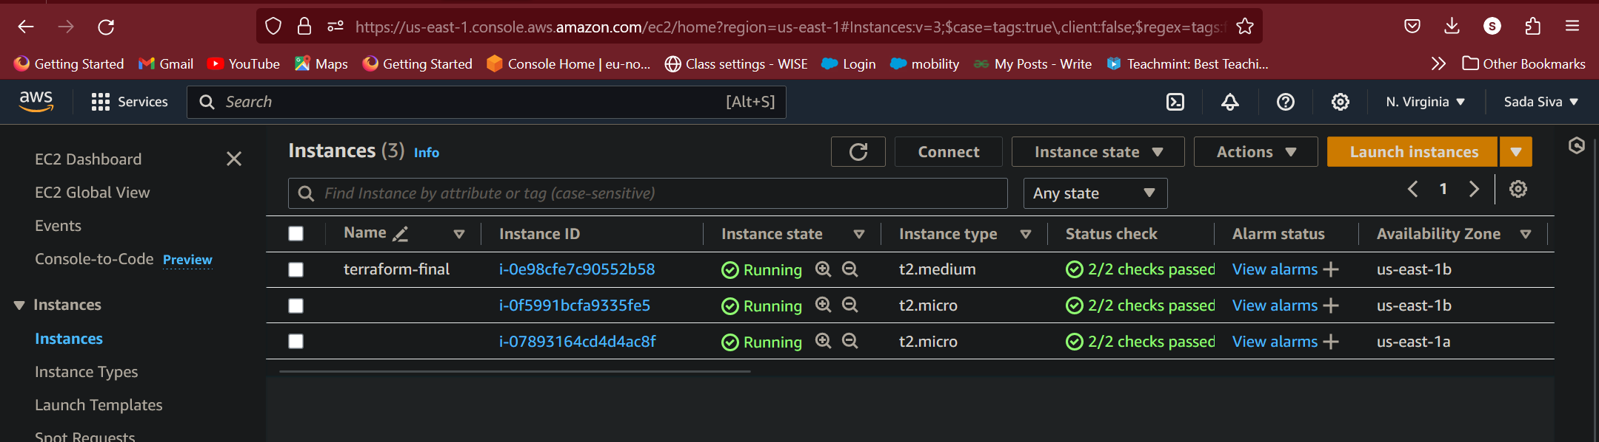
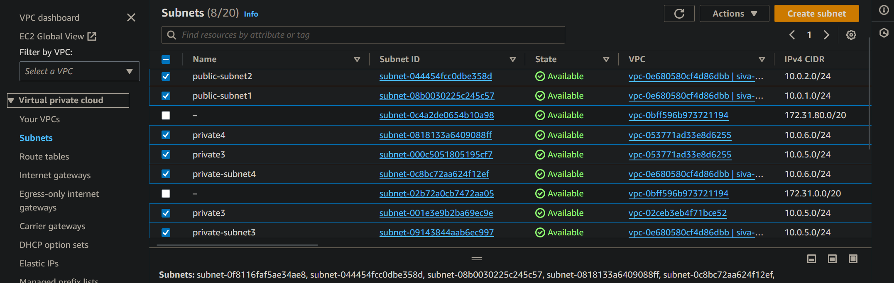
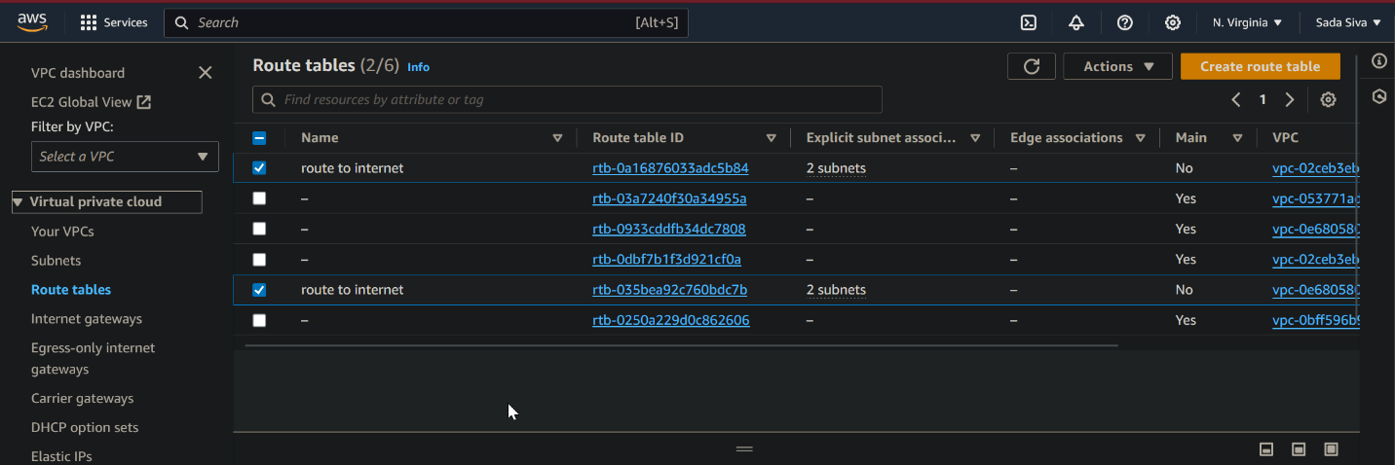
INSTANCES, PUBLIC & PRIVATE SUBNETS AND ROUTE TABLES

Slide 48
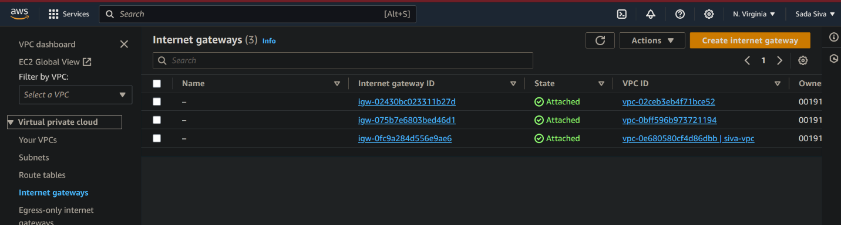
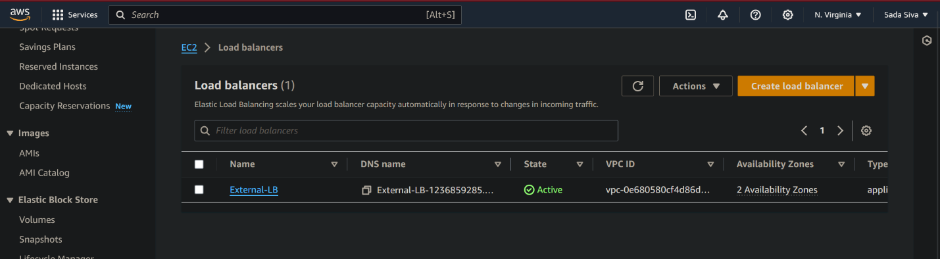
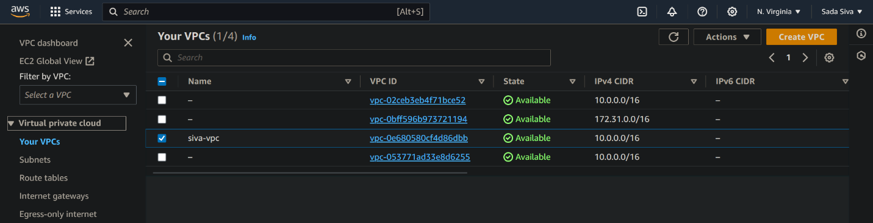
Load Balancer →→
Created Resources
→→Internet Gateway
→→VPC

Slide 49
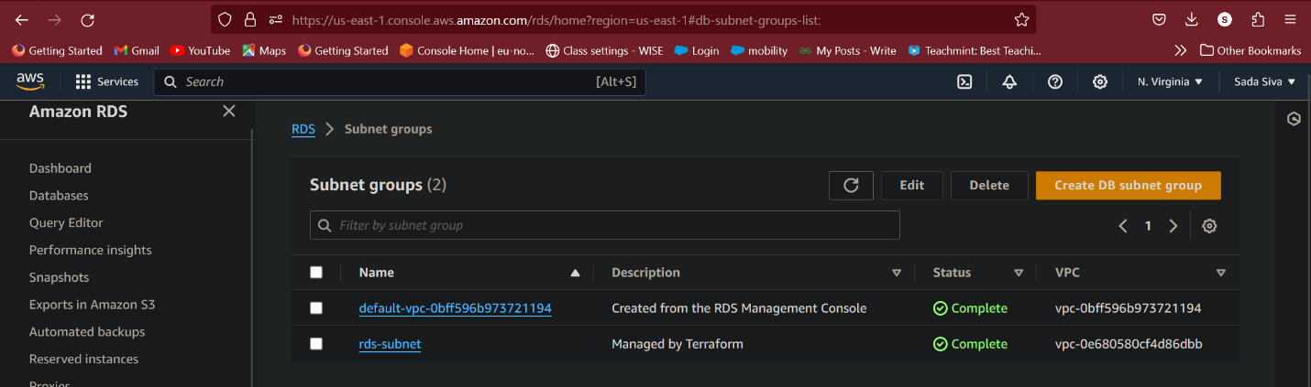
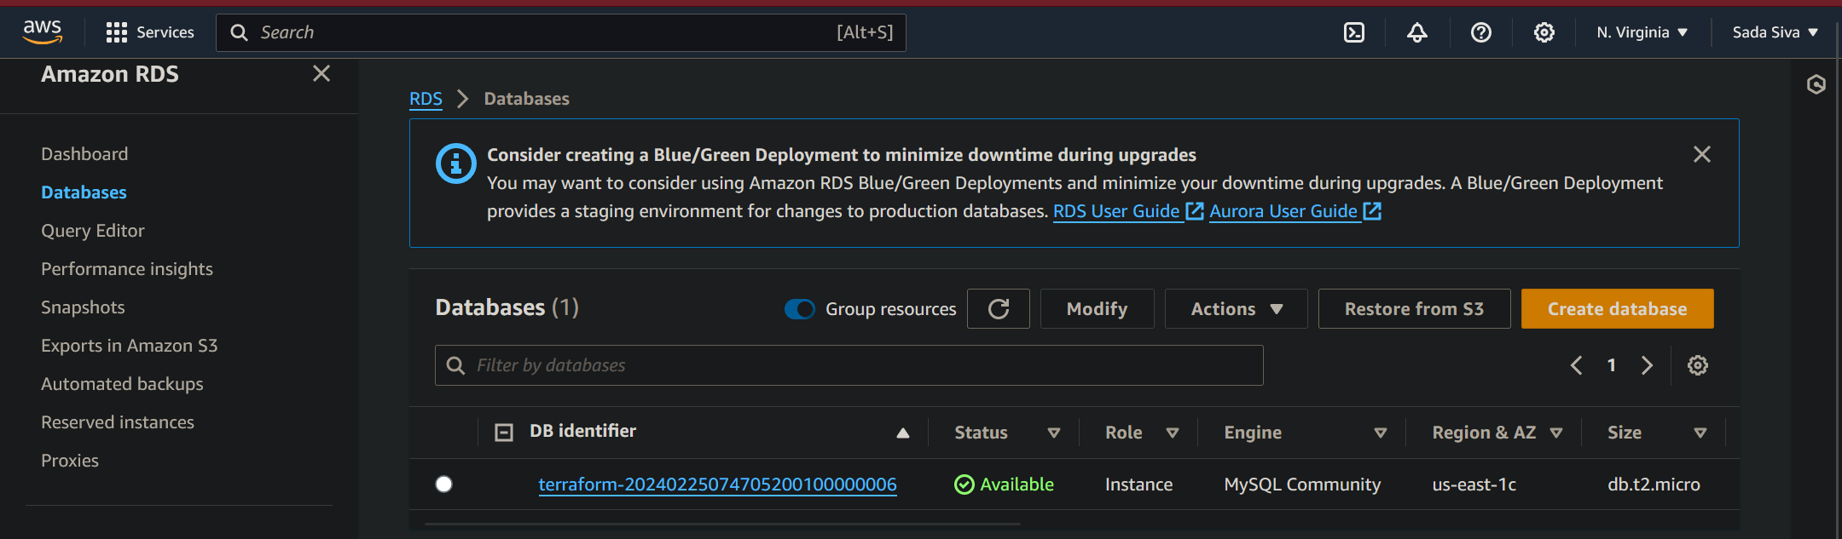
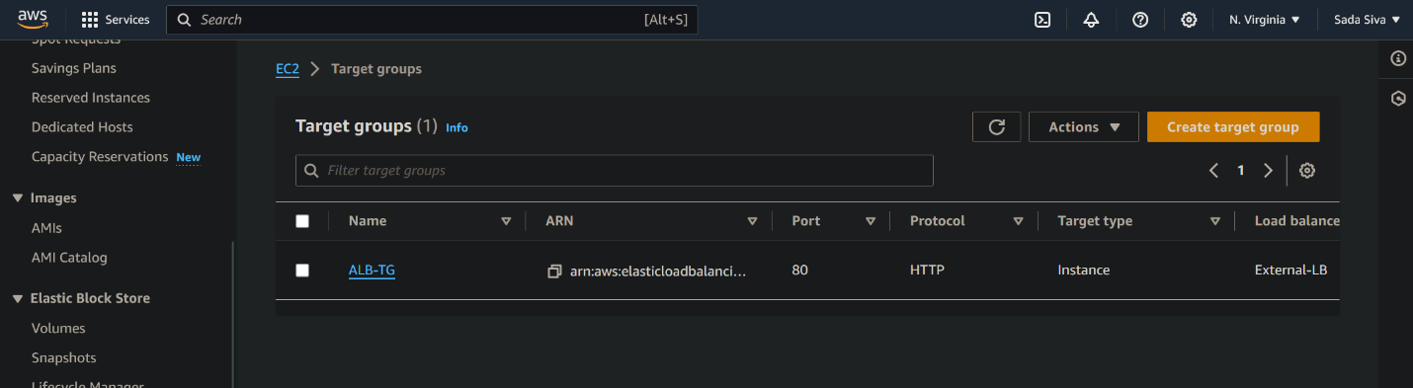
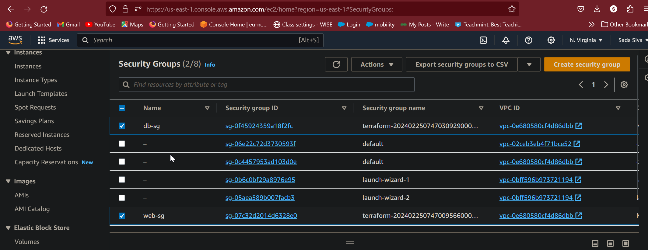
Created Resources

